Slide 1
Global Alignment
Biological Sequence Analysis
Made By:
Menna Sharaa
Passant Mohamed
Ghada Mamdouh
Mahmoud Khaled

Slide 2
What is Global Alignment?
A global alignment is an alignment of every amino acid or nucleotide found in your related sequences over their entire lengths, Global alignments aren't useful at all for discovering similarities between two sequences because the statistical method for evaluating E-values doesn't apply to them.
It is defined as the end-to-end alignment of two strings s and t.
It was one of the first applications of dynamic programming to compare biological sequences. The algorithm was developed by Saul B. Needleman and Christian D. Wunsch and published in 1970.

Slide 3
What is used for ?
Global alignments are usually done for comparing homologous genes like comparing two genes with same function (in human vs. mouse) or comparing two proteins with similar function. Used for finding out conserved patterns in DNA sequences or conserved domains or motifs in two proteins.

Slide 4
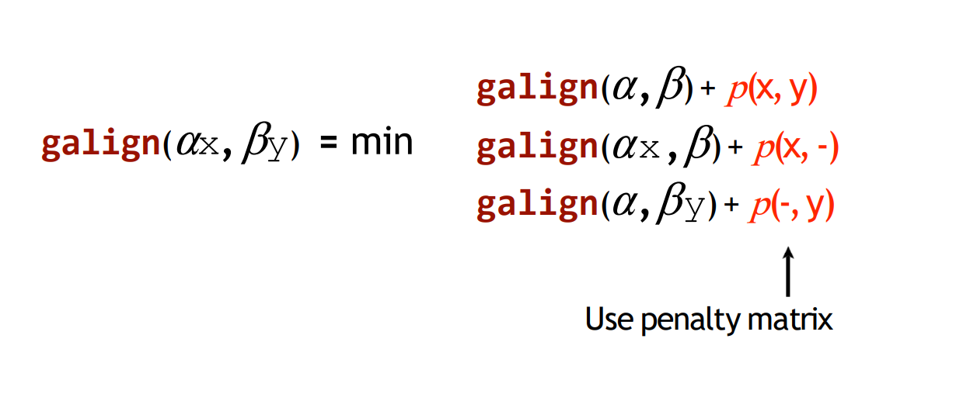
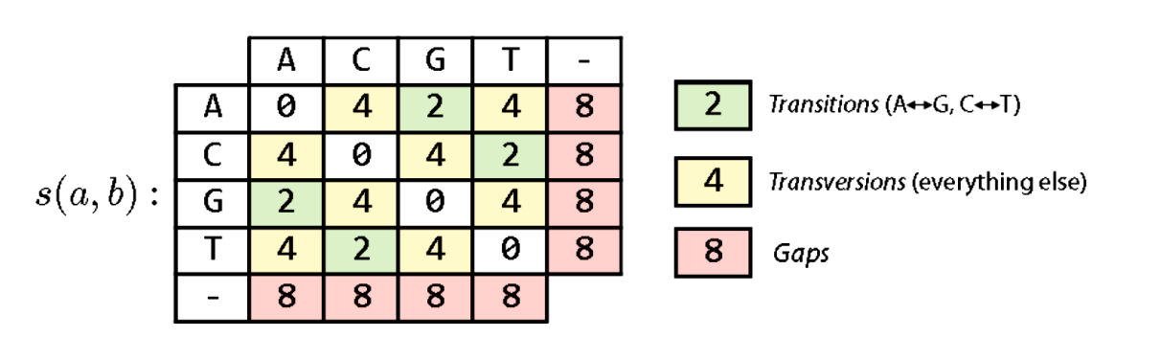
Example of Algorithm
∈ C A G G T C A G
∈
0 | 8 | 16 | 24 | 32 | 40 | 48 | 56 | 64
8
16
24
32
40
48
56
C
?
A
G
T
C
G
G

Slide 5
Example of Algorithm
∈ C A G G T C A G
∈
0 | 8 | 16 | 24 | 32 | 40 | 48 | 56 | 64
8
16
24
32
40
48
56
0 + 0
MIN: 8 + 8 8 + 8
C
0
A
G
T
C
G
G

Slide 6
Example of Algorithm
Example of Algorithm
∈ C A G G T C A G
∈
8 + 4
MIN: 0 + 8 16 + 8
0 | 8 | 16 | 24 | 32 | 40 | 48 | 56 | 64
8 | 0
16
24
32
40
48
56
C
8
A
G
T
C
G
G

Slide 7
Example of Algorithm
∈ C A G G T C A G
∈
0 | 8 | 16 | 24 | 32 | 40 | 48 | 56 | 64
8 | 0 | 8 | 16 | 24 | 32 | 40 | 48 | 56
16 | 8 | 0 | 8 | 16 | 24 | 32 | 40 | 48
24 | 16 | 8 | 0 | 8 | 16 | 24 | 32 | 40
32 | 24 | 16 | 8 | 4 | 8 | 16 | 24 | 32
40 | 32 | 24 | 16 | 12 | 6 | 8 | 16 | 24
48 | 40 | 32 | 24 | 16 | 14 | 10 | 10 | 16
56 | 48 | 40 | 32 | 24 | 20 | 18 | 12 | 10
C
Fill the matrix cells using same method
A
G
T
C
G
G

Slide 8
Example of Algorithm
∈ C A G G T C A G
0 | 8 | 16 | 24 | 32 | 40 | 48 | 56 | 64
8 | 0 | 8 | 16 | 24 | 32 | 40 | 48 | 56
16 | 8 | 0 | 8 | 16 | 24 | 32 | 40 | 48
24 | 16 | 8 | 0 | 8 | 16 | 24 | 32 | 40
32 | 24 | 16 | 8 | 4 | 8 | 16 | 24 | 32
40 | 32 | 24 | 16 | 12 | 6 | 8 | 16 | 24
48 | 40 | 32 | 24 | 16 | 14 | 10 | 10 | 16
56 | 48 | 40 | 32 | 24 | 20 | 18 | 12 | 10
∈
C
A
G
T
C
Backtracking
G
G

Slide 9
Example of Algorithm
∈ C A G G T C A G
0 | 8 | 16 | 24 | 32 | 40 | 48 | 56 | 64
8 | 0 | 8 | 16 | 24 | 32 | 40 | 48 | 56
16 | 8 | 0 | 8 | 16 | 24 | 32 | 40 | 48
24 | 16 | 8 | 0 | 8 | 16 | 24 | 32 | 40
32 | 24 | 16 | 8 | 4 | 8 | 16 | 24 | 32
40 | 32 | 24 | 16 | 12 | 6 | 8 | 16 | 24
48 | 40 | 32 | 24 | 16 | 14 | 10 | 10 | 16
56 | 48 | 40 | 32 | 24 | 20 | 18 | 12 | 10
∈
C
C A - G T C A G
A
G
C A G G T C G G​
T
+8
(gap)​
+2
(transition)
C
G
G

Slide 10
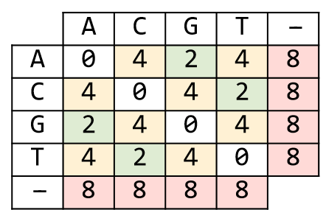
Scoring matrix rules
If 2 characters are the matching. If 2 if characters are different but transition.
If 2 characters are different but transversion. If there is a gap.
penalty matrix rules:
0
2
4
8

Slide 11
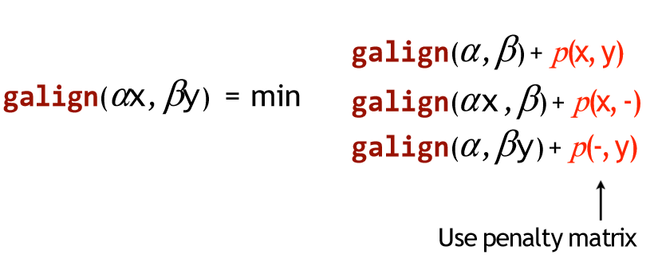
Scoring matrix rules
build (m+1) x (n+1) matrix “whare m & n are length of 2 sequences”.
(this additional one is for empty prefix).
start to fill up matrix cell by cell:
by comparing(aligning) 2 substrings of 2 sequences that is determined by
the position of the cell, then apply rules of penalty matrix to get score of this
cell.
after filling the entire matrix, we apply backtracking on the matrix to get global
alignment, using the next rule according to penalty matrix above :

Slide 12
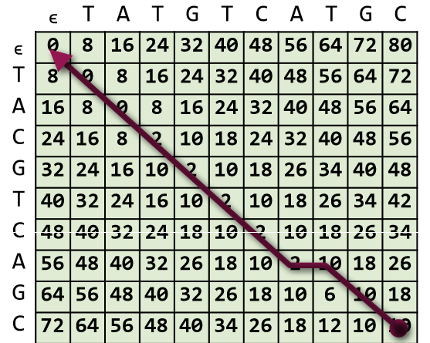
applying backtracking as shown below:

Slide 13
Thank You

